Slide 1
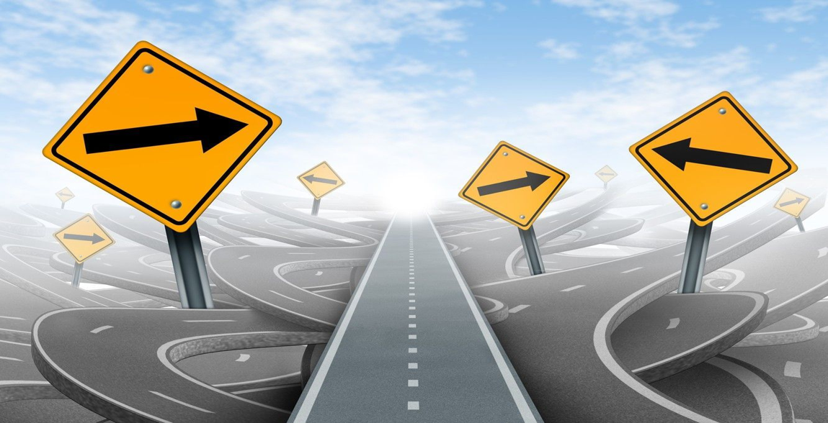
Capstone Project on TRAFFIC SIGN RECOGNITON
Prepared by Farooq Shaikh
Under the guidance of
Mr. Rithik Raj Vaishya

Slide 2
ABSTRACT
Traffic sign are designed in such a way that they can contain specific shapes and colors, with some text and some symbols with high contrast to the background.
Traffic sign recognition plays a crucial role in enhancing road safety and facilitating intelligent transportation systems.
This project proposes an innovative approach to address the challenges associated with accurate and efficient traffic sign recognition using Convolutional Neural Networks (CNNs).

Slide 3
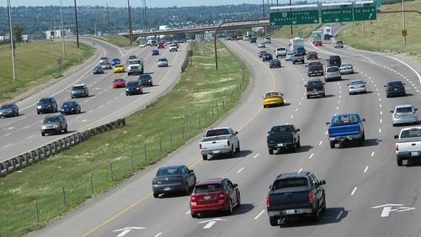
Introduction….
In this era of Artificial Intelligence, humans are becoming more dependent on technology.
With the enhanced technology, multinational companies like Google, Tesla, Uber, Ford, Audi, Toyota, Mercedes-Benz, and many more are working on automating vehicles.
When you go on the road, you see various traffic signs like traffic signals, turn left or right, speed limits,
Likewise, autonomous vehicles also have to interpret these signs and make decisions to achieve accuracy
In this Deep Learning project, we will build a model for the classification of traffic signs available in the image into many categories using a convolutional neural network(CNN) and Keras library.

Slide 4
OBJECTIVE
The main objective of the Traffic Sign Recognition is to identify a traffic sign from a digital photograph.
The sign may be viewed from various angles and in many diverse background situations.
Traffic sign after identification should classify signs with high accuracy rate.

Slide 5
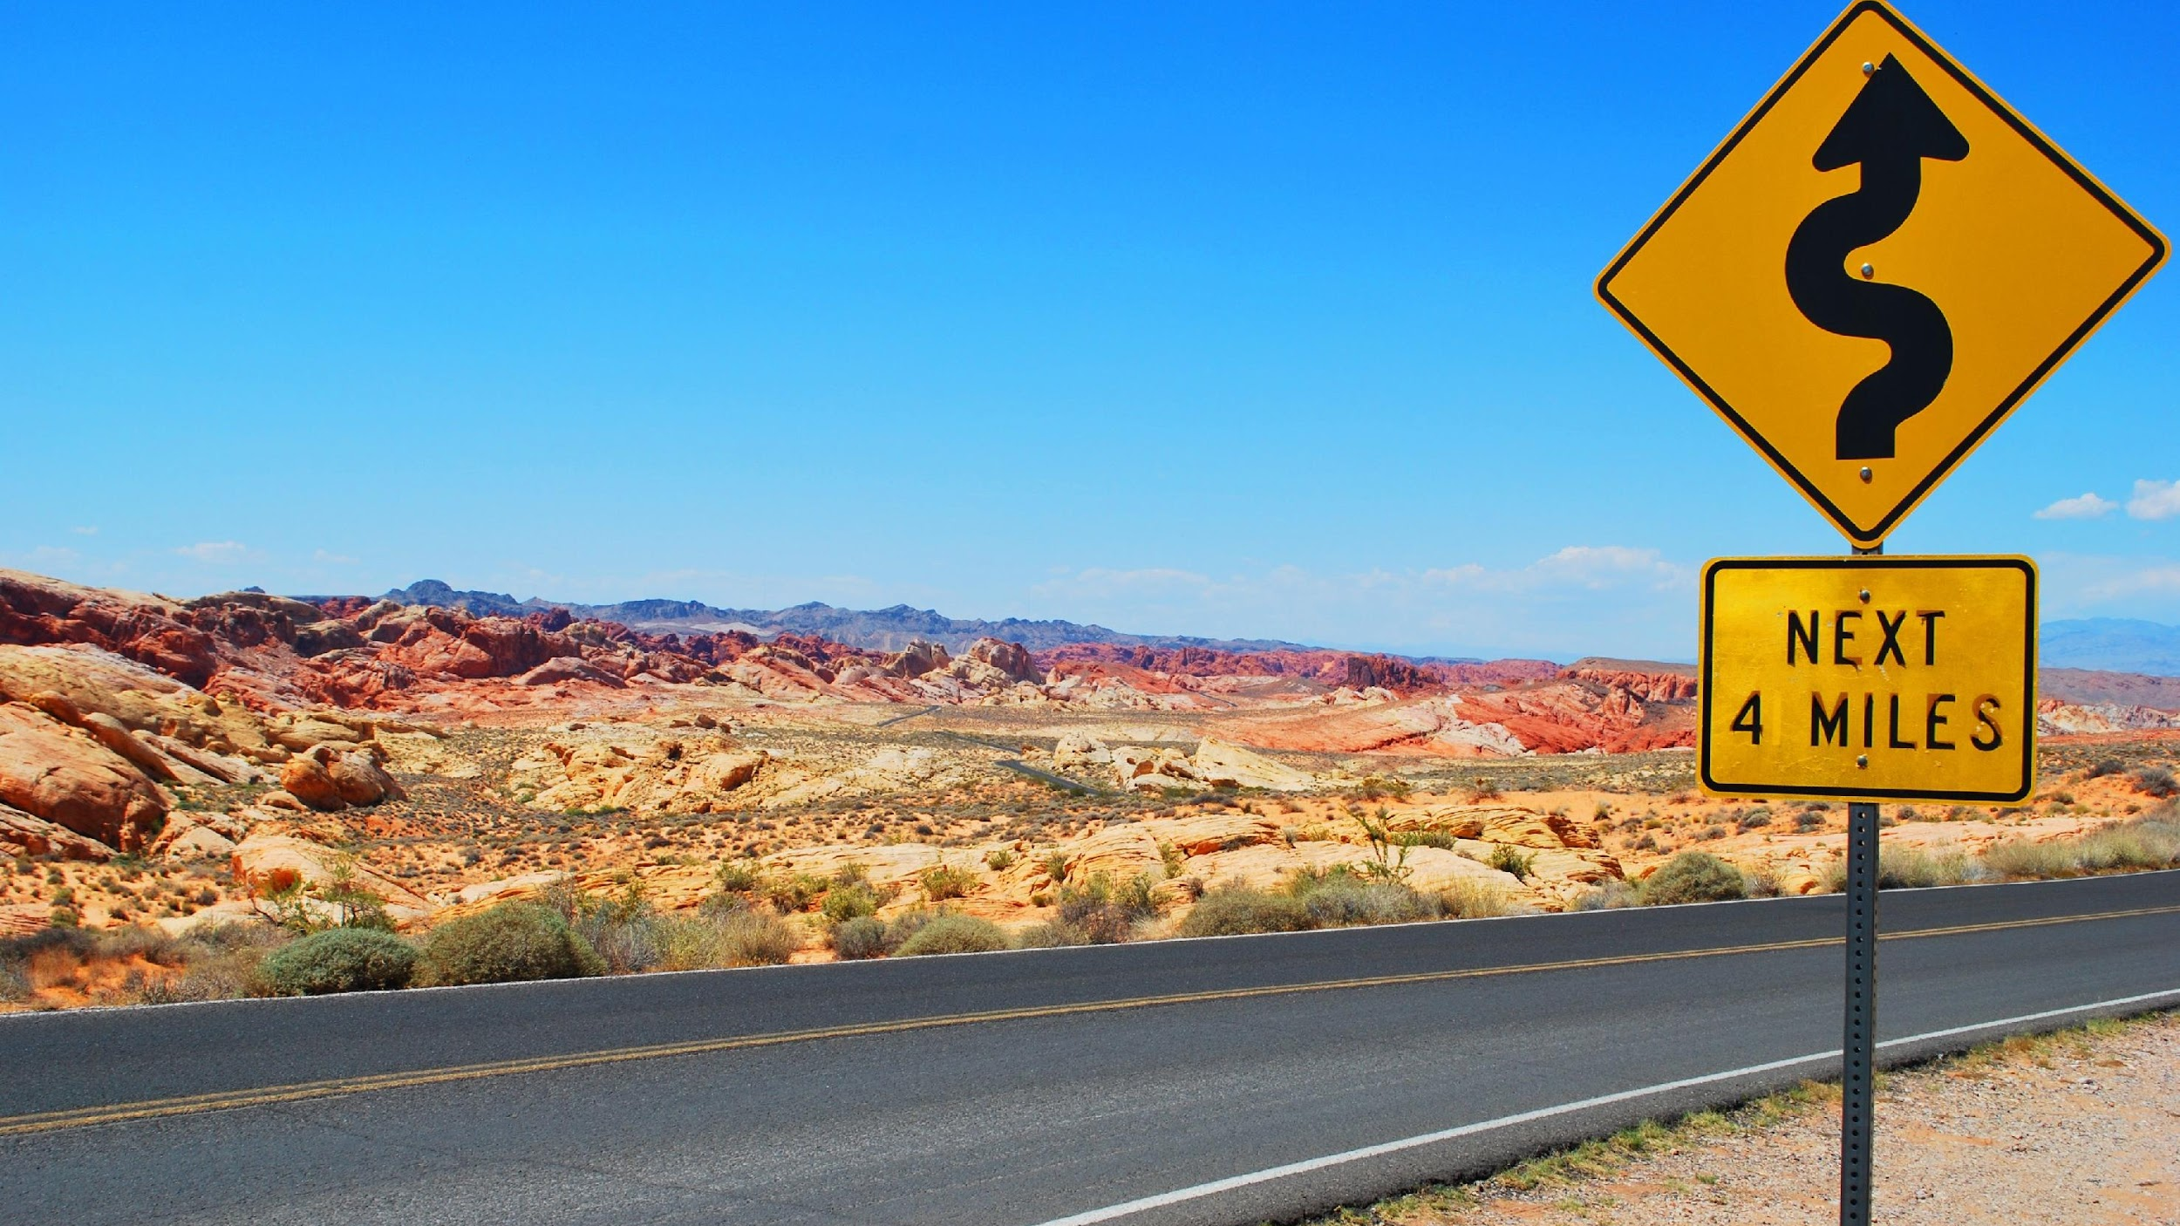
Implementation
Dataset
Traffic signs recognition
43 unique traffic signs
Python libraries
TensorFlow
Keras
Open CV
Model Used
Convolutional Neural Network

Slide 6
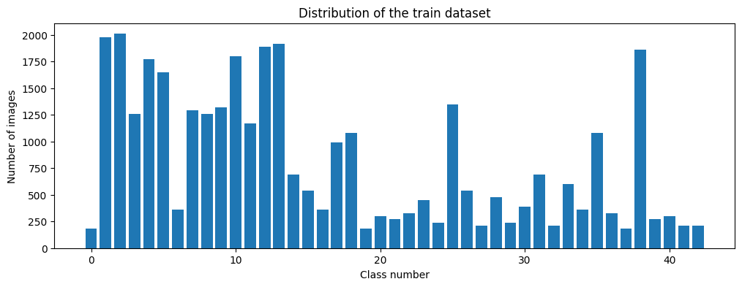
Distribution of the dataset images

Slide 7
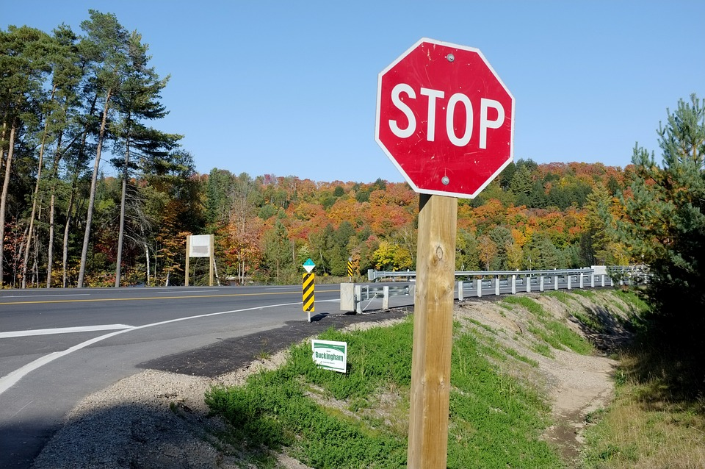





How we preprocessed and used the data….
Read the images from the directories
Read the labels
Reduce the size of the image to 32 by 32
Preprocess the image by grayscaling, equalizing and reducing the pixels
Splitting the data to train test split

Slide 8
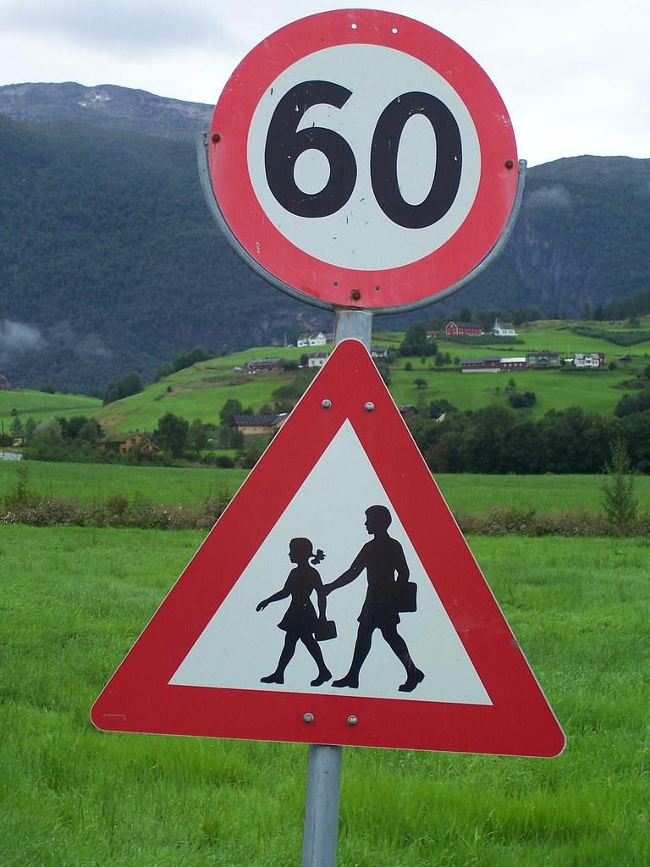
How we created our model….
Creating
Creating a Sequential model
Adding
Adding the first convolution layer
Adding
Adding the second Convloution layer
Doing
Doing the first maxpooling
Adding
Adding the third convolution layer
Adding
Adding the fourth convolution layer
Pooling
Applying pooling
Adding
Adding the dropout and flattening the image
Adding
Adding the output layer with 43 different classes

Slide 9
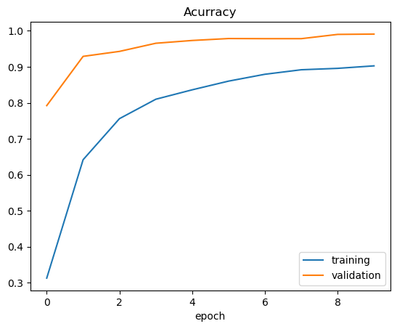
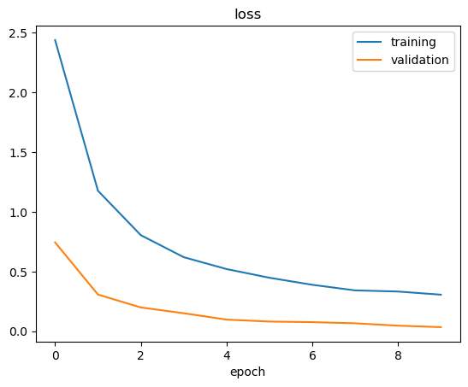
Accuracy and Loss we achieved...

Slide 10
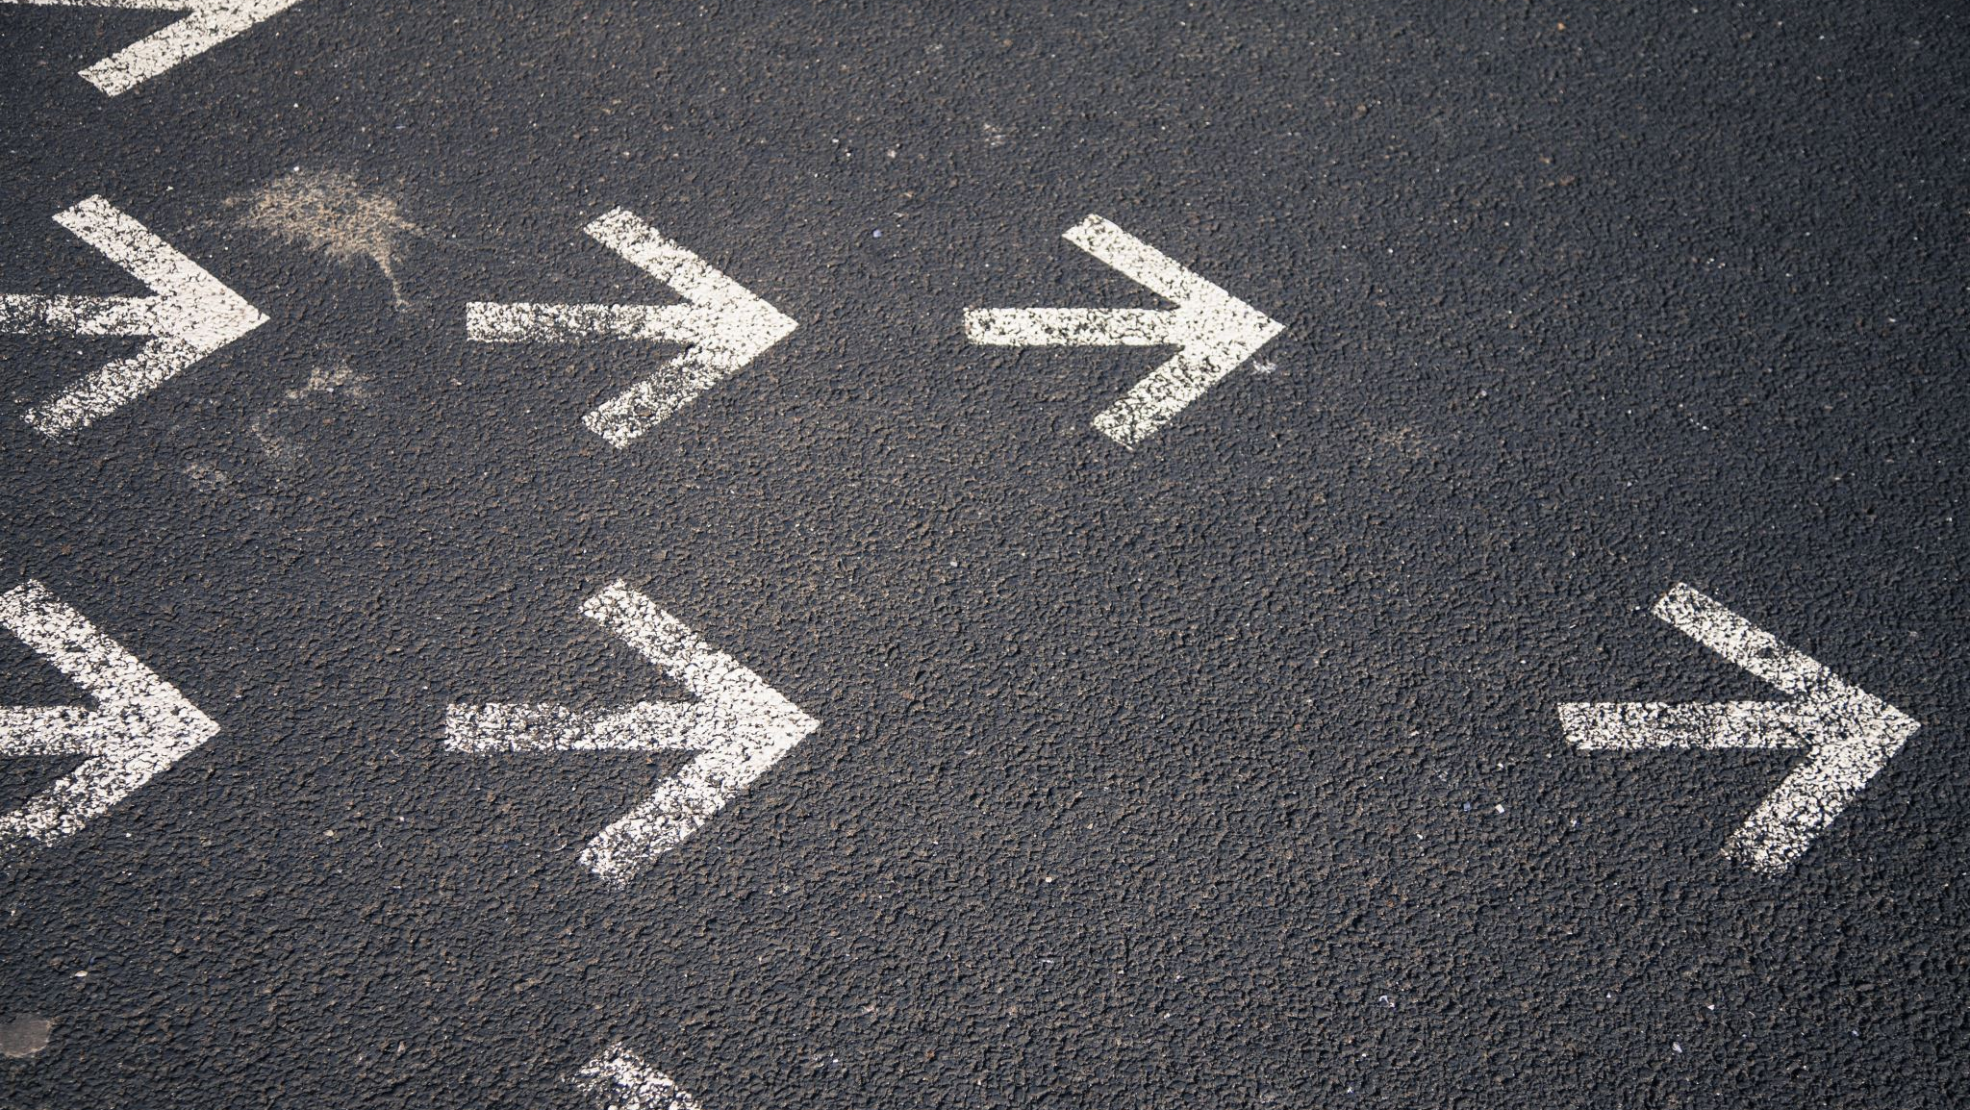
Output….

Slide 11
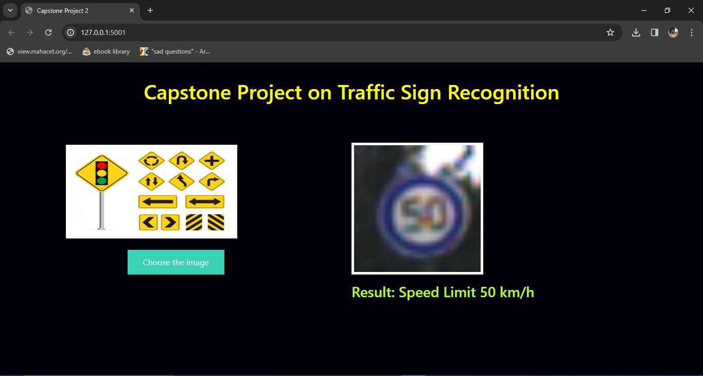
Speed Limit 50 km/h

Slide 12
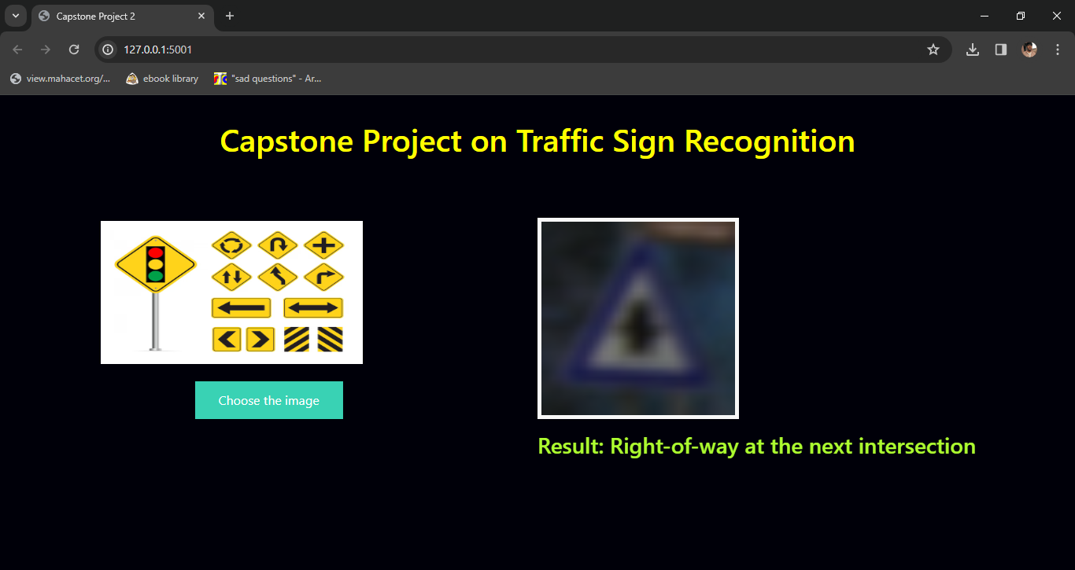
Right-of-way at the next intersection

Slide 13
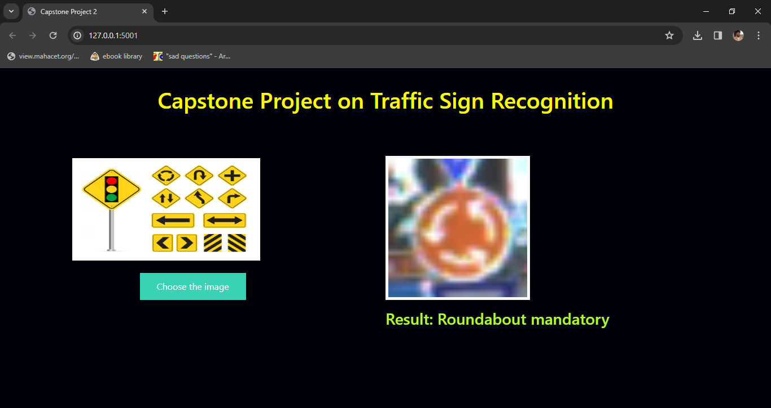
Roundabout mandatory

Slide 14
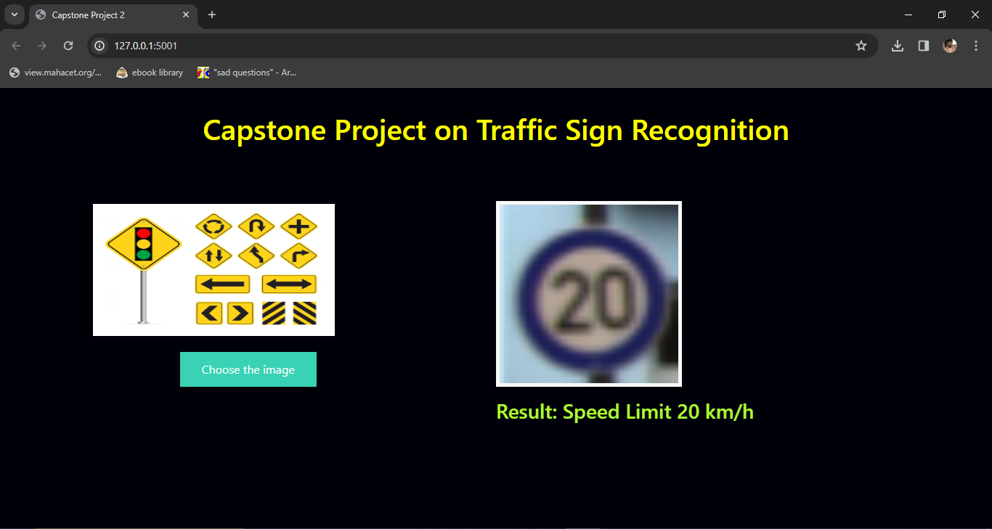
Speed Limit 20 km/h

Slide 15
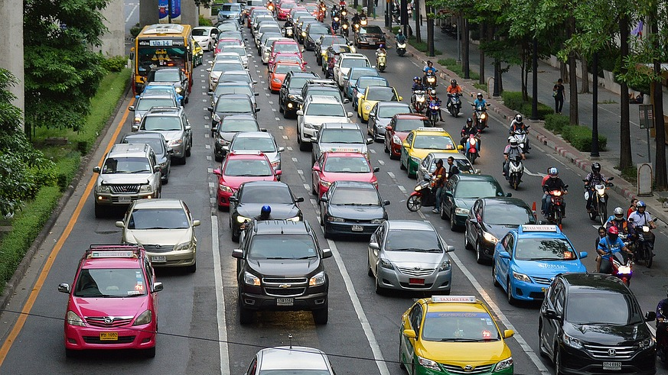
Future Enhancements…
In this study, the colors and design of a symbol are used to determine its identification. If there is a reflection on the sign that alters the color, this is a problem.
Nighttime detection
More datasets from different nations could improve overall performance and personalization.

Slide 16
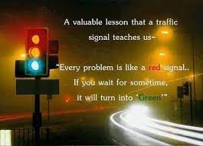
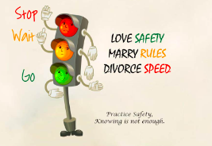
Thank You!

